Slide 1
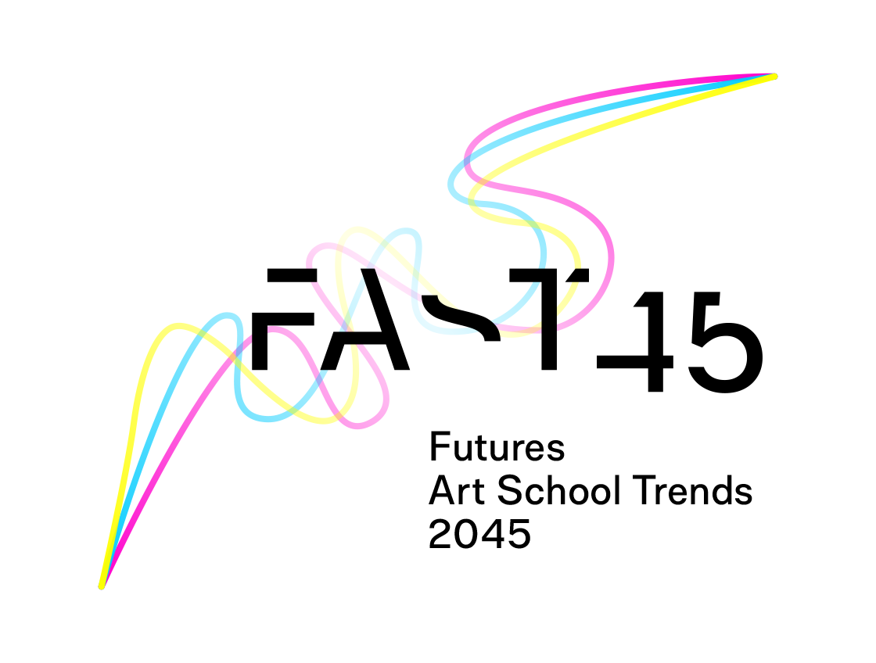
Art School Futures Lab
Dublin
1 & 2 November 2022
Notes:
Slide 1:

Slide 2
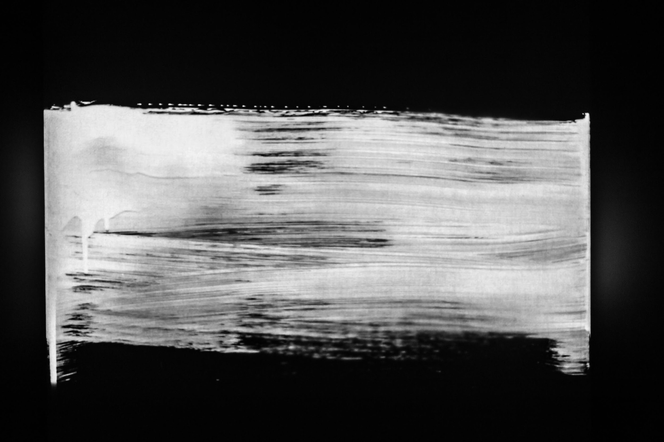
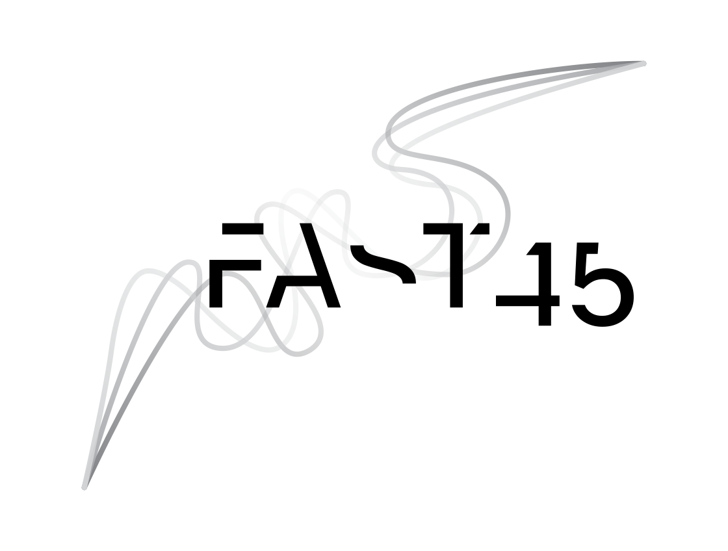
Focus
WELCOME
Creativity & Artificial Intelligence in IHAE
Aim & objectives
To explore drivers of change
To discuss futures images
To develop an artefact for a futures archive
To visit the futures archive
Informed consent
FAST45 – Art School Futures Lab - Dublin
Notes:
Slide 2: Glenn (1’)
We are asking for your permission to record the outputs of this workshop by videotaping, photography and recording. The materials are used for research, development and teaching purposes in the FAST 45 project. We follow the open data principle and thus the materials become open to the Social Information Archive. We strive to anonymize the material you produce, but we cannot guarantee complete anonymity. Is this ok for you? Please complete the consent letter.

Slide 3
The lab’s ethos
Everyone's ideas and perspectives are valuable
Give space for each group member
Use all your experience
There are no wrong ideas – futures are different from today
Wild ideas – use bold imagination!
FAST45 – Art School Futures Lab - Dublin
Notes:
Slide 3: Glenn (1’)
Use clear hand writing.
The use of brave magination is desirable.
Go wild with your ideas when brainstorming and discussing ideas.
There are no false thoughts or wrong ideas in this workshop – there are just ideas about possible futures.
These ideas don’t have to be real or possible yet. The world is changing fast – these ideas might be possible in 20 years time.
Start with short presentation round – just name and one of your favourite film directors

Slide 9
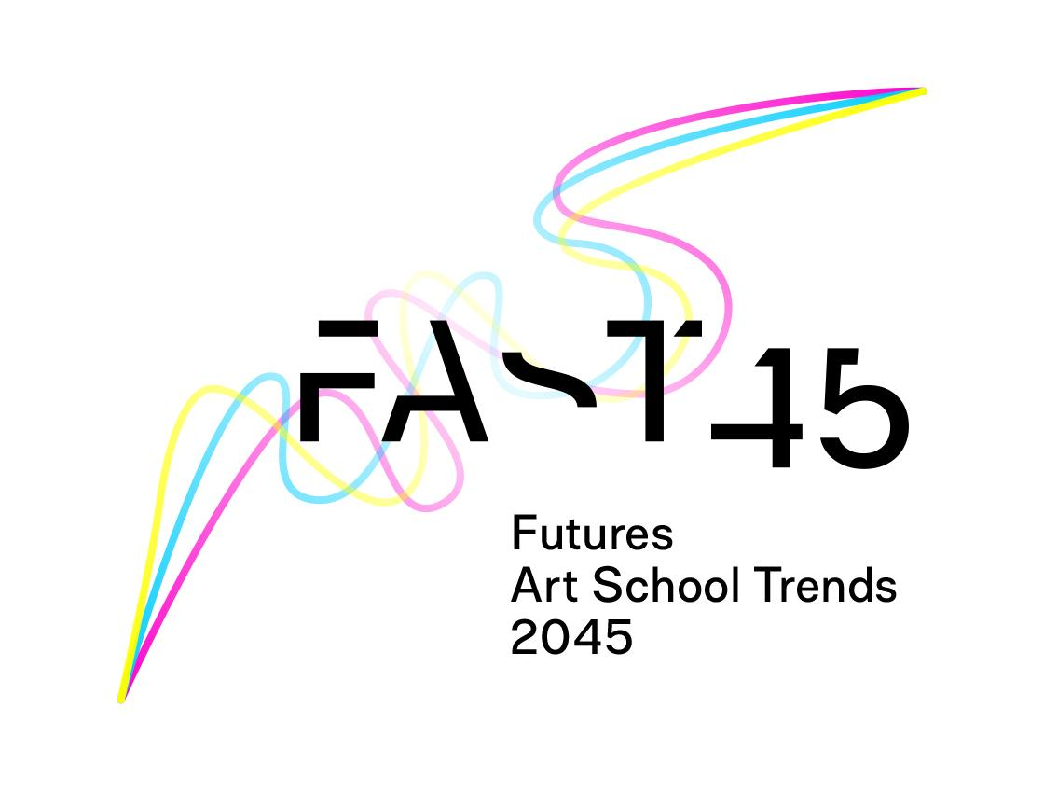
Erasmus+ Knowledge Alliance
To explore and inventory existing ideas and visions
data map / learning platform
To organise Art School Futures Labs
labs in 6 IHAEs
To determine futures images and scenarios
develop a futures archive
To organise a debate on possible policy and decision actions
discussion document / agenda
FAST45 – Art School Futures Lab - Dublin
Notes:
Slide 4: Koenraad (2’)
to explore and inventory already existing research that substantiate ideas and visions of possible, probable, or preferable futures for IHAE and the employment of artists.
to organise Art School Futures Labs that enhance futures thinking and imagining alternative futures inside IHAE (= in collaboration with students, lecturers, researchers, and heads of programs, departments or institutes) and outside IHAE (= in collaboration with external public and private social and economic partners).
to determine futures images and scenarios that highlight the discontinuities from the present and reveal the potential choices and their potential consequences that IHAE need to prepare for their longer-term future planning and decision-making.
to organise a general discussion / debate on possible policy and decision actions that informs and facilitates transformative leadership for strategic steps forward.

Slide 10
Future jump (01.11.2022)
Presentation Stuart Candy
The Art of Futures / Future for the Arts
Everyone thinks about the future –– but too rarely do we have the chance to learn how to do a better job of it. This presentation will offer an overview of practices from the field of futures / foresight, and raises the question of how artists and arts education might contribute to the emergence of social foresight, a much-needed, yet still nascent, collective human capacity to think ahead systematically and creatively.
Stuart Candy is an Associate Professor in the Carnegie Mellon School of Design. An award-winning foresight practitioner, designer, artist and educator, his work aims to augment our capacity for navigating alternative futures by any means necessary. At CMU he is responsible for integrating foresight / futures practice throughout the design curriculum.
FAST45 – Art School Futures Lab - Dublin
Notes:
Slide 11: Glenn (30’)

Slide 11
Working Documents

Slide 12
About Futures
Not predetermined, not predictable
We can create alternative futures images (e.g., possible, plausible, probable, preferable, imaginary, preposterous)
Our decisions and actions affect the future
Open value discussion inevitable and important
FAST45 – Art School Futures Lab - Dublin
Notes:
Slide 5: Kai
Western scientific worldview
From the futures studies perspective, the future is unpredictable it is not predetermined - it does not yet exist.
(Scientific worldview) . E.g. Covid and its impact on people, organizations and entire societies.
we can create images, visions, perceptions, and scenarios of future events — we can imagine alternative futures and we can consider which of the different options are possible, probable, desirable, or undesirable.
It is important to note that we can influence the future with our own decisions and actions or non –action – e.g. we should not continue our consumption habits as business as usual – if we wish to avoid sevier ecological difficulties.
We are involved in making the future at all times - often unconsciously.
When possible futures are imagined and discussed, we need to stay open to different ideas. Futures thnking also involves value discussion – e.g. whose preferble (my.., my country.., other species...).

Slide 13
Futures images
framed by our scientific knowledge and cultural understandings of the world.
can include:
realistic and imaginary elements
preferable, unpreferable, or neutral elements
FAST45 – Art School Futures Lab - Dublin
Notes:
Slide 6: Kai
Futures images we create are framed by our understanding the world – the scientific and the cultural – even they can include imaginary – not possible yet elements. Still they are limited to our imagination – which can be very powerfull (Verne imagined in 1800 – visit moon – submarine – when those things were technically totally impossible.

Slide 14
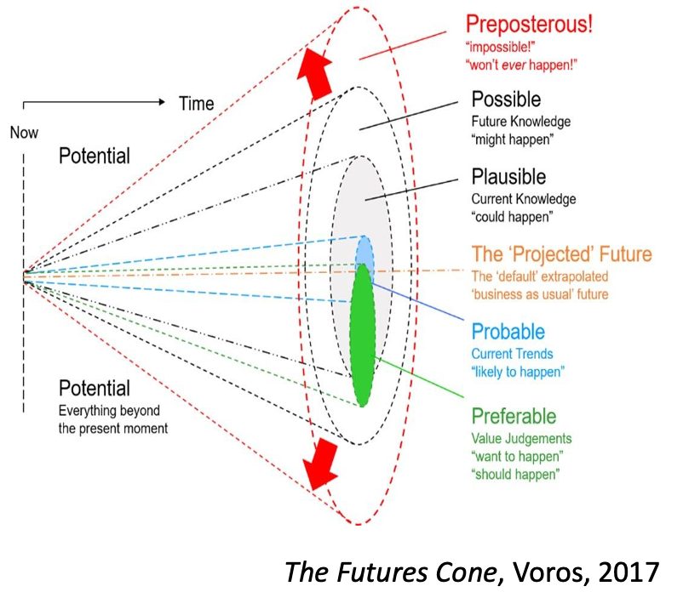
Futures images
FAST45 – Art School Futures Lab - Dublin
Notes:
Slide 7: Kai
The Futures cone is one way to “structure” futures and contemplate the probability of our images of alternative futures.

Slide 15
Drivers of the future
What kind of driving forces (= drivers of change) influence our future operational environment?
Which driving forces may have the most impact?
How these driving forces are forming the futures? (most likely, possibly, and in what ways)?
FAST45 – Art School Futures Lab - Dublin
Notes:
Slide 8: Kai
One tool in foresight is mapping and identifying of the driving forces which are the drivers of changes in our operational environment -
Which have the most impact and how they are influencing the future?

Slide 16
Drivers of futures
Megatrends
Slowly changing phenomena with clear developmental direction forming the future.
Trends
Trends are clearly visible phenomena that causes change (a development of change).
Counter-trends
(Slowly changing) phenomena countering or opposing existing (mega)trends
What’s next?
FAST45 – Art School Futures Lab - Dublin
Notes:
Slide 9: Kai
Megatrends: For example
Climate change, biodiversity loss and limited natural resources -> materials, touring and travel
Technological development: digitalisation, automatication, robots, artificial intelligence
-> recording, distribution, pedagogies
Globalisation and interdependence
-> cultural influences, networks
Population growth, aging of population particularly in western societies -> audiences, amateur artists
Urbanisation -> accessibility in rural areas
Trends
The impacts of a trend are not as strong and inevitable as megatrends they can influence a shorter period of time
Some trends can be amplified and transformed into megatrends
e.g. local food / fashion…, land traveling
-> e.g. shared ownership, artists as activists
Counter trends – opposing existing (mega)trends e.g. slow food / life / university

Slide 17
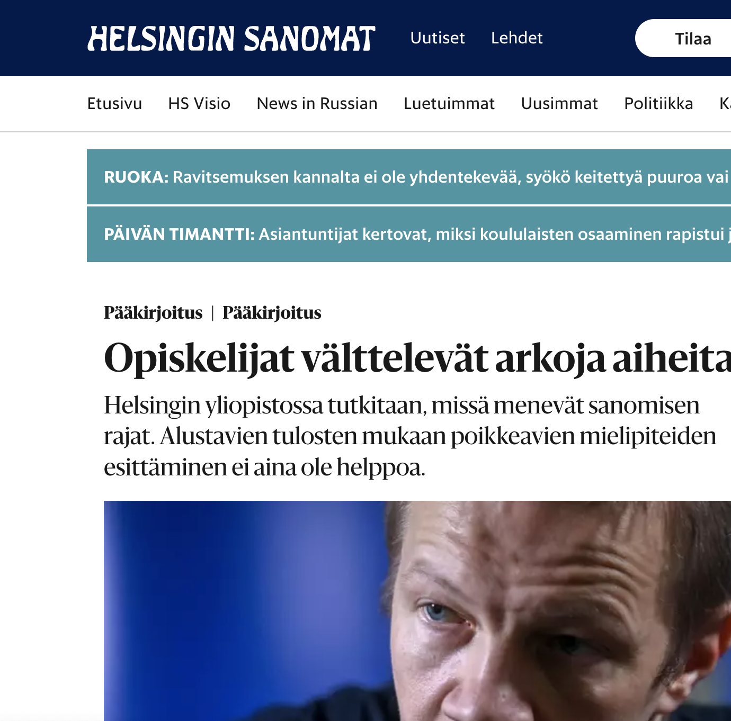
Emerging trend: an example
Students avoid sensitive topics
The University of Helsinki is exploring the limits of what can be said. Preliminary results show that it is not always easy to express dissenting opinions.
At the University of Helsinki, a study is underway that has attracted interest even before it was completed. It is a study by two educationalists - Mikko Puustinen and Jenni Marjokorvi - on the debate atmosphere at the University of Helsinki. The study ties in with the debate in recent years about whether different opinions on issues such as gender, ethnicity or sexual minorities are accepted at the university or in society at large.
In the researchers' initial survey, 55% of students felt that "the climate at university discourages people from saying some things they believe in because others might find them offensive". Other responses also indicated that students are reluctant to raise issues or opinions that they perceive as inflammatory.
It is difficult to gauge the scale of the issue from a limited survey. It is probably a small phenomenon on the scale of the university - and society as a whole - but a real and heavy one for some sectors and students.
(Editorial, Helsingin Sanomat, 1. November 2022, transl. KL)

Slide 18
Drivers of futures
Weak signals
An indication of an emerging issue or an early sign of a change that may be meaningful in the future
Wild cards / Black swans
Events and things, with very small probability, but with dramatic effects or impact.
What if …?
FAST45 – Art School Futures Lab - Dublin
Notes:
Slide 10: Kai
Weak signals: e.g., universal income for artists, hologram dancers, AI composed music
Wild Cards / Black Swans: 9/11, Pandemic, a sudden and great increase of energy prizes
A sign of a new thing or a new element of an old one
May even cause a radical change and often predicts a sudden change of trends
Cannot be based on statistical reliability and continuity
Often looks funny, odd or insignificant
Weak signals help us to explore and imagine more radical changes and alternative futures – what if society, work, home, family, education… were something different than today as what if all the artist would receive universal basic income?

Slide 19
Political as directives, legislation, political interests and movements, etc.
Economic as public economy, employment, industries, spending power, etc.
Social as demography, education, health, etc.
Technological as new technologies, technological development, use of technology, etc.
Environmental as climate, biodiversity, natural resources, pollution, infrastructures, etc.
Cultural as religions, beliefs, lifestyles, consumption habits, the arts, etc.
(Dufva, 2022)
PESTEC analyses
A tool to identify future changes & drivers
Use post-its
Solo work (5 min.)
FAST45 – Art School Futures Lab - Dublin
Notes:
Slide 12: Kai (5’)
Task: Identify individually futures changes and what drives them in general (in pestec). Name for each aspect one example. Connect them (where possible) to the values and principles in Stuart Candy’ presentation.
NB! Please write in English!!
Glenn prepares individual pestec templates
Participants work individually on their own pestec table.
Afterwards (in the break) the participants can read the thoughts of other colleagues.

Slide 20
Horizon Scanning
Part 1
What concepts of creativity exist in art school today? Where do they come from?
What current trends (values / principles) can potentially affect future ideas of creativity and creative practice in IHAE?
What weak signals (values / principles) could you identify that may have relevance for ideas of creativity and creative practice in IHAE?
Part 2
Walk around and read the thoughts of others.
Add dots on ideas you would like to discuss further.
Use post-its
Solo work (5 + 15 min.)
FAST45 – Art School Futures Lab - Dublin
Notes:
Slide 15: Kei (5’)
Parts 1
Participants write on post-its and put them on the table (one idea – one post-it)
Please write in clear handwriting.
NB Please write in English!
Part 2:
Participants choose by dot-voting (use as many dots as you which), and form duo’s (find a conversation partner)..

Slide 21
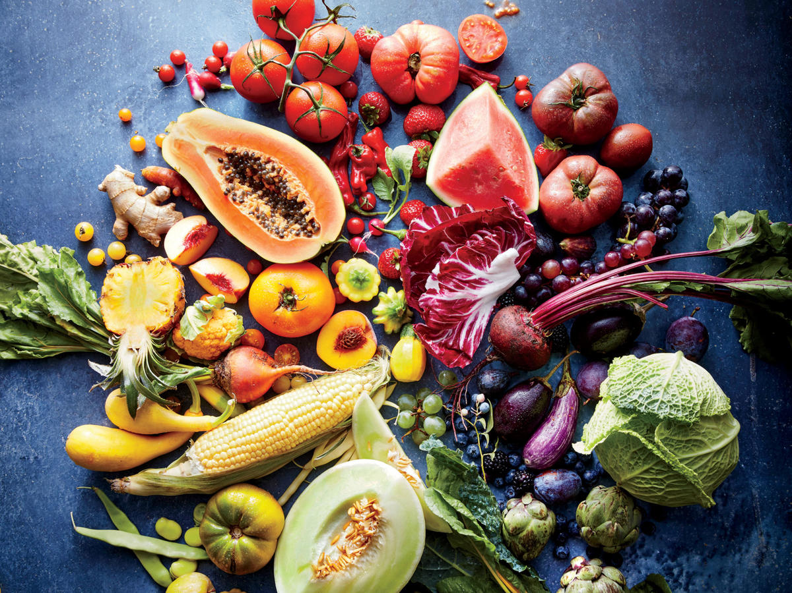
Break
15 minutes
FAST45 – Art School Futures Lab - Dublin

Slide 22
Moving towards a futures image
Starting from the trends and weak signals you’ve written and read:
How are the understandings of creativity and creative practice changed by 2045?
In what ways are they enabled or threatened by technological innovation?
How will creativity be taught in the art school in 2045?
Imagining the futures of HAE
Group work (30 min.)
FAST45 – Art School Futures Lab - Dublin
Notes:
Slide 17: Kai (30’)
What concepts of creativity exist in art school today?
In what ways are they enabled / threatened by technological innovation?
How will creativity be taught in the art school in the future?
Participants discuss and argue in groups. They can use the questions but don’t have to answer them formally. The questions are just starters.
Participants collect important ideas / suggestions on paper.
These ideas will be used to develop the artefact (futures archive).

Slide 23
From futures images towards an artefact
Futures Archive
Some ideas of what you could create:
a physical ‘object’
a digital artefact like an email from a student, or a vlog, a podcast, an XR experience, a recorded class, a meme, …
a newspaper article
an organogram
a mindmap
a recording of an art performance
a page from a design magazine
an online or offline brochure from an art school
a soundscape
an advertisement
meeting minutes
a map
a photograph (you can use ai tools to help you with this!)
a official patent of a new technology
…
FAST45 – Art School Futures Lab - Dublin
Notes:
Slide 19: Koenraad

Slide 24
The exhibition label
Futures Archive
Tell ‘the story’ of the object.
The 5 W’s: when / what / who / where / why.
Describe the key components and main principles of the world in which the artefact ‘lives’.
Describe the change drivers that led to this situation, main principles, and key components of favorable culture.
Write in the present tense.
Title of the artefact / Materials that the artefact is made of / Name of the team members / Text for the label (max 230 words / 1200 characters)
FAST45 – Art School Futures Lab - Dublin
Notes:
Slide 20: Koenraad

Slide 26
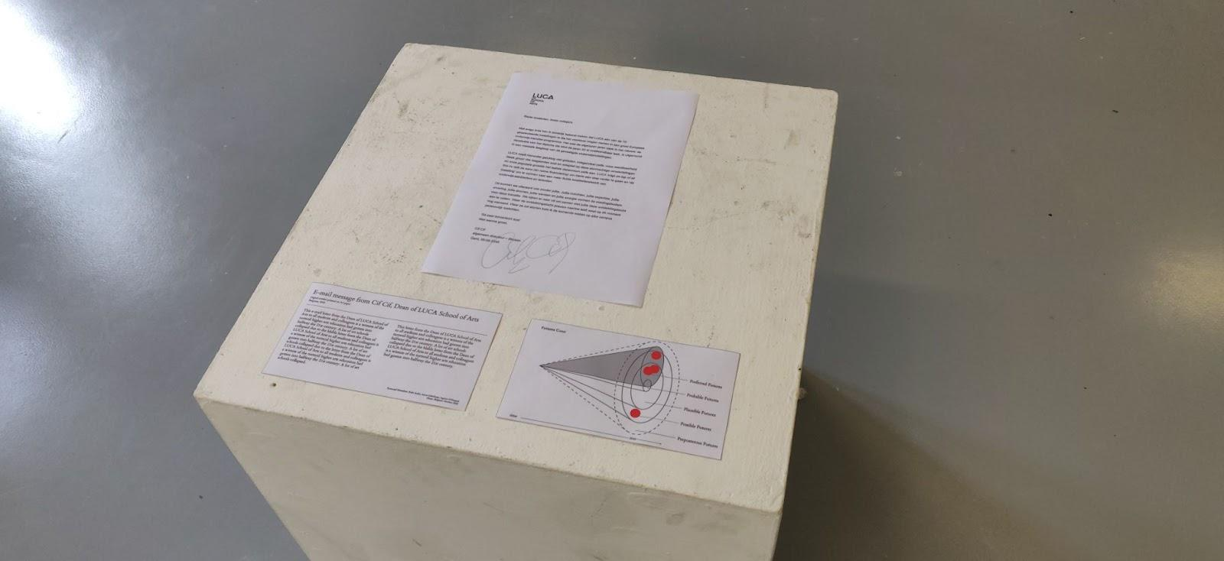
The Futures Archive
Notes:
Slide 21: Koenraad

Slide 27
The Futures Archive
Notes:
Slide 22: Koenraad

Slide 28
Steps to take
Futures Archive
Brainstorm on the question what future artifacts (archive objects) could tell something about 2045, incorporating the topics and ideas that you have discussed within the future image.
Decide which artefact you will create (you can work as a group, a duo, or individually).
Start creating! Don’t forget to take enough time to write the exhibition label.
FAST45 – Art School Futures Lab - Dublin
Notes:
Slide 18: Koenraad

Slide 29
Present your artefact
Futures Archive
Present your artefact for the group (max. 3’)
FAST45 – Art School Futures Lab - Dublin
Notes:
Slide 23: presentation is done by participants (group after group)
Recorded (who will record?)

Slide 30
Discussion
Futures Archive
FAST45 – Art School Futures Lab - Dublin
Notes:
Slide 23: discussion lead by Kai (recorded by ??)

Slide 31
Thank you!
Kieran Corcoran
kieran.corcoran@TUDublin.ie
Koenraad Hinnekint
koenraad.hinnekint@luca-arts.be
Kai Lehikoinen
kai.lehikoinen@uniarts.fi
Glenn Loughran
glenn.loughran@TUDublin.ie
Conor Mcgarrigle
conor.mcgarrigle@TUDublin.ie
contact details
www.
.eu
Presentation title
Notes:
Slide 24: closing words (Glenn)

Slide 32
Moving towards a futures image (01.11.2022)
Starting from the trends and weak signals you’ve written and read:
How are teaching/learning practices in IHAE changed by 2045?
What kind of new methods and approaches have been embedded?
What is the “good old” that has remained?
What are teaching philosophies and values?
How are things organized in IHAE in general?
How does it feel for you to be in those institutions?
What brings joy and what frustrates you?
Imagining the futures of HAE
Group work (30 min.)
FAST45 – Art School Futures Lab - Dublin
Notes:
Slide 17: Kai (30’)
Participants discuss and argue in groups. They can use the questions but don’t have to answer them formally. The questions are just starters.
Participants collect important ideas / suggestions on paper.
These ideas will be used to develop the artefact (futures archive).

Slide 33
Future jump (02.11.2022)
Presentation Joanna Walsh
Joanna Walsh is a multidisciplinary writer for print, digital and performance. The author of eleven books (some co-written with AI that she has coded), Joanna also created digital narratives and public art projects, as well as writing, directing and performing solo and collaborative works.
​
She’s an arts activist, and mentor for emerging and established writers.​ Joanna is also a university teacher, editor, and illustrator.
FAST45 – Art School Futures Lab - Dublin
Notes:
Slide 11: Glenn (30’)

